Slide 1
Church & Politics
Presented to KSCF Nyandarua Associates
By Rev. Kepha Nyandega on 19th Oct 2025

Slide 2
Should the Church be involved in Politics?
Matthew 5: 13-16
¹³ “You are the salt of the earth. But if the salt loses its saltiness, how can it be made salty again? It is no longer good for anything, except to be thrown out and trampled underfoot.
¹⁴ “You are the light of the world. A town built on a hill cannot be hidden. ¹⁵ Neither do people light a lamp and put it under a bowl. Instead they put it on its stand, and it gives light to everyone in the house. ¹⁶ In the same way, let your light shine before others, that they may see your good deeds and glorify your Father in heaven.

Slide 3

Outline
Introduction
  What is Church, Politics?
Should the Church engage in Politics?
Kenya and Global experiences with politics
Effective Christian Engagement in Politics
Conclusion

Slide 4
Introduction: Where is the Voice of the Church?
The question is often asked when a country is grappling with socio political challenge or even natural disaster like Covid 19.
The questions reveals that:
  The Society is in need of guidance
  The Church should offer that needed guidance (Amos 3:7)
  The Church voice is either too faint or silent over the issue at hand
  When asked by Christians, they mean the church leaders and not themselves as individual Christians have a duty to influence politics or policies of the land.
  Church has one ‘voice’ on such issues

Slide 5
Introduction…
When it comes to Church and politics, 4 perspectives is evident among Christians:
  Isolation - Politics so dirty, don’t be involved. Informed by dichotomy between the secular and sacred
  Assimilation – Politics too important, take it over
  Indifference – I don’t care.
  Integration – Separate entities but Church salts politics, politics may also influence the church
Church and Politics is about a balanced relationship between Church and Politics- how the Church can effectively influence politics of the land without losing its ‘churchiness’.
What is Church?
  Comprehensively includes the individual believer or community of believers in a locality and all that the Church stands for (ideas- teachings, values, message, etc)
What is Politics?
  Set of activities that are associated with making decisions in groups, or other forms of power relations among individuals, such as the distribution of resources or status in a nation or group – Online Cambridge Dictionary
  Politics is about who gets what, when and how? – Harold Lasswell, 1936

Slide 6
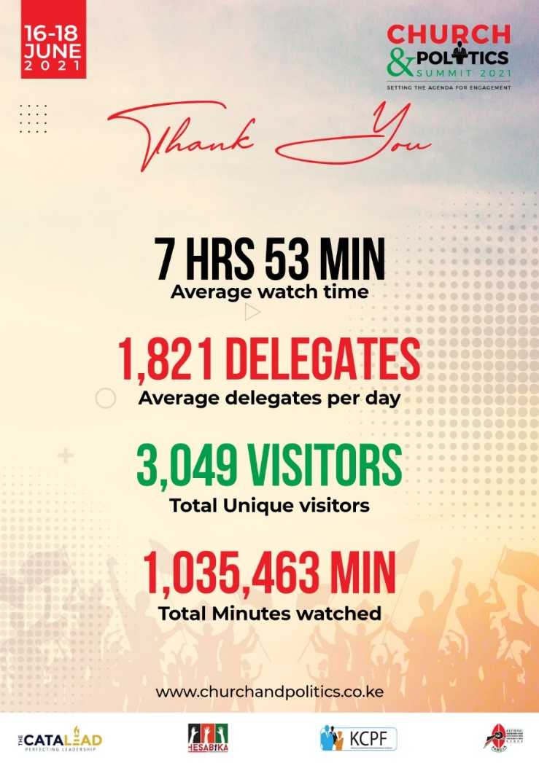
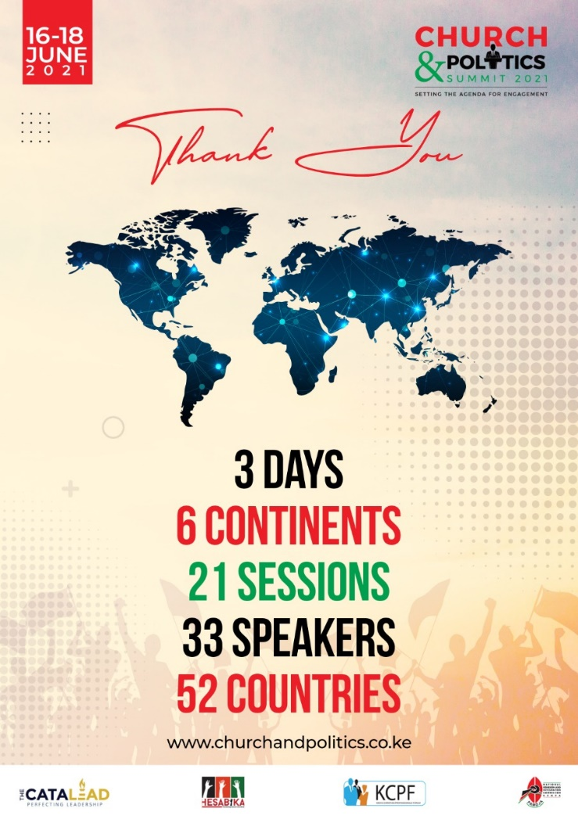
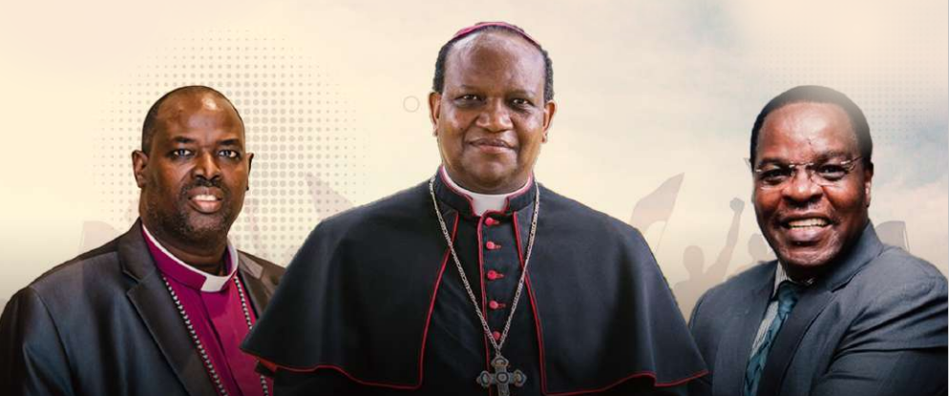
Introduction: About Church & Politics Summit…
C&P Summit Expected Outcomes
Identify lessons from others
Outline action points for the Church
Develop criteria of leaders for the country
Establish guidelines for politicians engagement with the Church
C&P Summit Participants: heads of churches, Christian leaders, individual Christians and umbrella Organisations – NCCK, EAK, KCCB, OAIC,
C&P Bible Study Guide is based of the
deliberations of the conference

Slide 7
Should the Church be involved in Politics?...
Jesus uses 2 metaphors: Salt and light for Church relationship with society to imply that:
  The believers/ church as salt must interact with the earth (society) to influence or ‘salt’ it. ‘Out of the Salt Shaker’ by Rebecca Pippert
  It is possible for the church to lose her identity (saltiness) as it seeks to influence society.
  As light, the Church must give direction, expose wickedness and must be separate enough from it to illuminate the world, yet close and open enough for the ‘dark’ world to see it.

Slide 8
Should the Church be involved in Politics?....
Politics shape destinies of nations – Siasa mbaya, maisha mbaya, H.E daniel Arap Moi, former President Moi
‘If believers are to shape society positively as God’s stewards, it follows that influencing its politics is an integral part of the process. It is our God given missional mandate, and failing at it would mean we have failed our Master- Bishop Oginde, C&P Summit, 2021
In fact, the Bible is a political book – Abraham would be a blessing to nations, he confronted kings and rescued his nephew lot; Moses revolted against Pharaoh of Egypt and Joshua concurred Canaan to settle Israelites; Daniel was a prime minister in t least 4 regimes, Jeremiah, Isaiah, etc advocated for justice and confronted wicked kingdoms, etc
Jesus himself was political – his birth, his teachings and his ministry unsettled kings. He is the King of Kings, the Lord of Lords.
If the Church is committed to the cause of Christ, we cannot afford to ignore political engagement.

Slide 9
The Kenya Scenario
The summit therefore sought to answer 2 Questions
What would God want us to do about our politics?
How, exactly, do we ensure we act obediently and do this that God has called us to do?
But we must fist ask 2 questions:
What is our experience as Kenyan Church with regards to politics of the land?
What is happening in other countries?

Slide 10
The Kenya Church Experience with Politics
Our Kenyan history is replete with great influence the church has had on politics of the land:
  64% of Kenyan schools were founded by the Church through which many leaders were schooled. Mzee Kenyatta and freedom fighters were trained by and in church schools
  Current polytechnics were founded by the Church (NCCK) following a paper presented to Excom entitled, After Schools What?
  Second liberation was led by Church leaders – Bishop Henry Okulu, Bishop Alexander Muge, Bishop David Gitari, Bishop Ndingi Mwana-a-Nzeki, etc under the discussion, ‘the Kenya we Want’
  Reopening political space and return of multi party was led by church leaders like Rev Dr Timothy Njoya, Rev Mutava Musyimi and Christian politicians such as Prof Kivutha Kibwana, Prof Anyang’ Nyongo, etc
  We now know that the 2017 elections stalemate (handshake) was mediated by church leaders like Bishop David Oginde, Bishop Alfred Rotich, Archbishop Muheria, etc

Slide 11
The Kenya Church Experience with Politics ....
But it has not always been rosy. A number of Church leaders and Christian leaders and Christian in general have been a great disappointment – have lost their saltiness and we have been and are still collectively ‘no longer good for anything, except to be thrown out and trampled underfoot’ Matt 5:16b
KNBS 2019 Population Census report revealed that Christians were at 85.5% up from 80% in 2009.
Unfortunately, Kenya is one of the most corrupt countries in Africa, most unequal society and with high unemployment rate yet our politicians are some of the highest paid in the continent. (2nd highest paid lawmakers in the world, beating their counterparts from the developed economies of US, Britain and Japan, IMF report, 2013).
Why is the Church in Kenya doing so badly?
Bishop Oginde in the Summit listed: Division, Tribalism, Greed for money and Ignorance on the best strategy to engage politics.

Slide 12
The Global Experience
Kenyan situation isn’t in isolation; handling politics has been a challenge and success in a number of countries. In these nations, the Church, and especially the clergy have played significant roles in guiding and directing the political affairs of their nations.
In the 2020 USA Presidential Elections, for example, a section of the Church – especially the Evangelicals – was actively involved in various aspects of the Presidential campaigns and elections. Unfortunately, the elections turned out to be perhaps one of the most divisive in US history, with serious tensions, riots, and violence.
3 of American Christian leaders while addressing the Church & Politics Summit of 2021, Dr Ron Sider, Rev Adam Taylor and Bob Inglis, shared about their own failures, success and lessons in their 2020 elections.
4 such key lessons were that effective Church engagement in Politics requires:
  a biblical framework for Christian political involvement
  Maintaining integrity of the church by avoiding partisan endorsements
  Platforms for honest dialogue between different contenders.
  Courageously confronting societal evil and divisive practices eg negative ethnicity, and corruption

Slide 13
Effective Christian Engagement in Politics
Romans 2^{: 17} Now you, if you call yourself a Jew (believer); if you rely on the law and boast in God; ¹⁸ if you know his will and approve of what is superior because you are instructed by the law; ¹⁹ if you are convinced that you are a guide for the blind, a light for those who are in the dark, ²⁰ an instructor of the foolish, a teacher of little children, because you have in the law the embodiment of knowledge and truth— ²¹ you, then, who teach others, do you not teach yourself? You who preach against stealing, do you steal? ²² You who say that people should not commit adultery, do you commit adultery? You who abhor idols, do you rob temples? ²³ You who boast in the law, do you dishonor God by breaking the law?
Jesus himself admonished to watch how they engage with the world:
Matt 10: ¹⁶ “I am sending you out like sheep among wolves. Therefore be as shrewd as snakes and as innocent as doves.
We must learn how well to engage the murky waters of politics if we are to retain our saltines and remain light of the world.
As Dr Snider put it in the C&P Summit; the Church cannot afford to abandon politics as a “dirty game,” for two reasons.
Pragmatic reason - since politics shapes billions of lives of people in the world, for better or for worse, Christians need to leverage politics for common good.
Theological reason - the church has a compelling discipleship duty to bring every sphere of life, including politics, under the Lordship of Jesus Christ, for His honour. Failure to do so then amounts to disobedience to the Master!

Slide 14
Effective Christian Engagement in Politics …
The Summit identified at least 6 ways of engaging politics of the land:
Church as a Citizen – Balancing her twin identities – heavenly and on earth Phil 3:20, Matt 5:16
Church as a peace maker – Promoting peace and cohesion in the nation –Matt 5:9
Church as Participants – How can a believer enter the political arena - Joshua, Samuel, Daniel, Joseph, David examples
Church as advocate – Speaking for the powerless – Prov 31: 8-9, eg prophets Micah, Jeremiah, etc
Church as Mediator – Building bridges to a common good – 2Cor 5:20
Church a Custodian – safeguarding the moral fabrics of the society – 1Samuel 12: 1-15
These are covered in depth in the Church & Politics Bible Study Guide that members here may opt to adopt for your fellowships.

Slide 15
Conclusion
The Church of Christ must arise to be the salt and light of the world if we are to be the Church that He promised to build and even died for Matt 16:18.
Every sphere of life belongs to our God – including politics. The Church must redeem it!
  'There is not a square inch in the whole domain of our human existence over which Christ, who is Sovereign over all, does not cry, Mine!‘ - Abraham Kuyper
We must take hid of Christ imperative that believers must be salt and light of the world – Mat 5:13-16
“It is the church that is willing to die to worldly standards that will know the power of Christ’s resurrection. It may be envied for its depths of loving relationships or for its spontaneous joy; it may be hated and persecuted for its revolutionary lifestyle exposing the hollow values and destructive selfishness of the society it seeks to serve; but it certainly cannot be ignored. When God reigns among His people, they become a city set on a hill and cannot be hid” (David Watson in I Believe in the Church [Eerdmans], p. 61).

Slide 16
Conclusion
²⁷ Whatever happens, conduct yourselves in a manner worthy of the gospel of Christ. Then, whether I come and see you or only hear about you in my absence, I will know that you stand firm in the one Spirit,^{[a]} striving together as one for the faith of the gospel ²⁸ without being frightened in any way by those who oppose you. (Philippians 1: 27-28)
Thank You!

